Slide 1
Prior-free auctions of digital goods
Elias Koutsoupias University of Oxford

Slide 2

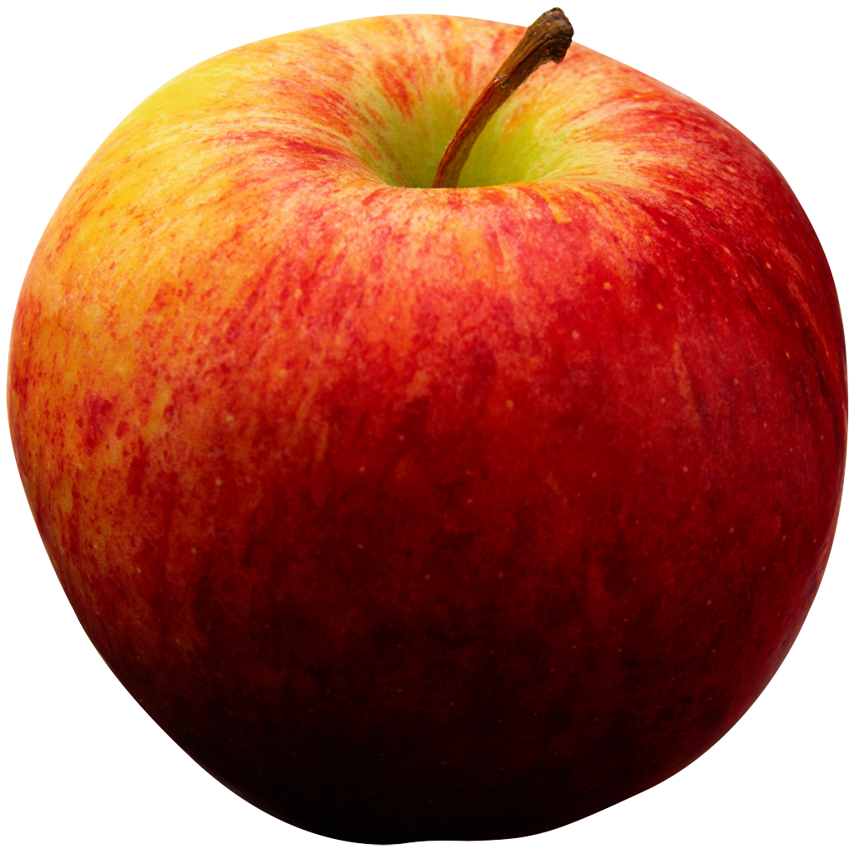
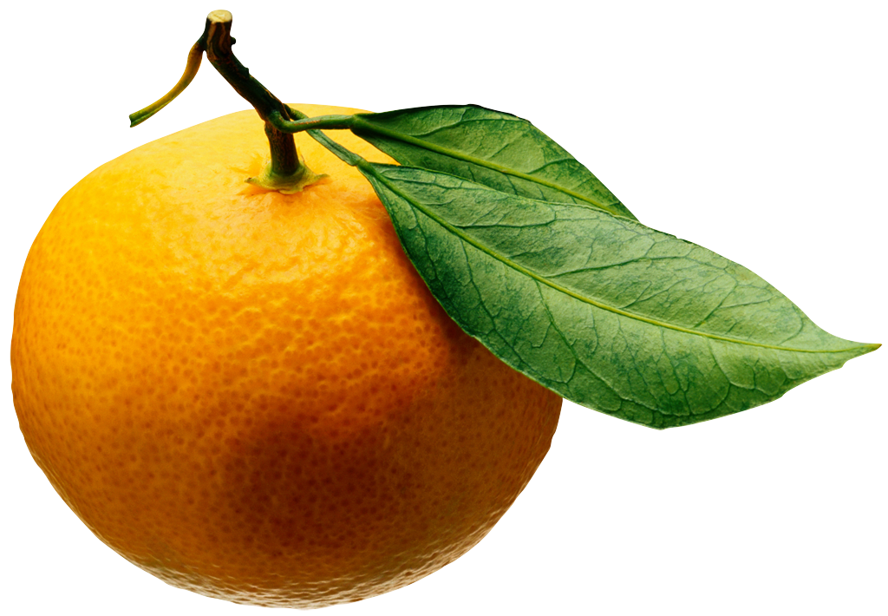
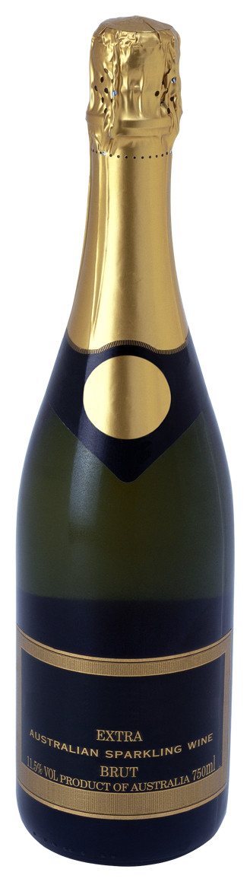
The landscape of auctions
Myerson designed an optimal auction for
single-parameter domains and many players The optimal auction maximizes the welfare of some virtual valuations
Combinatorial
Benchmark for evaluating auctions?
In the Bayesian setting, the answer is straightforward: maximize the expected revenue (with respect to known probability distributions)
Many items (additive valuations)
Major open problem
Extending the results of Myerson to many items is still an open problem
Even for a single bidder
And for simple probability distributions, such as the uniform distribution
Identical items (limited supply)
This talk
Myerson (1981)
Identical items (unlimited supply)
Single item
Symmetric, F⁽²⁾
Asymmetric, M⁽²⁾
Bayesian
Prior-free

Slide 3
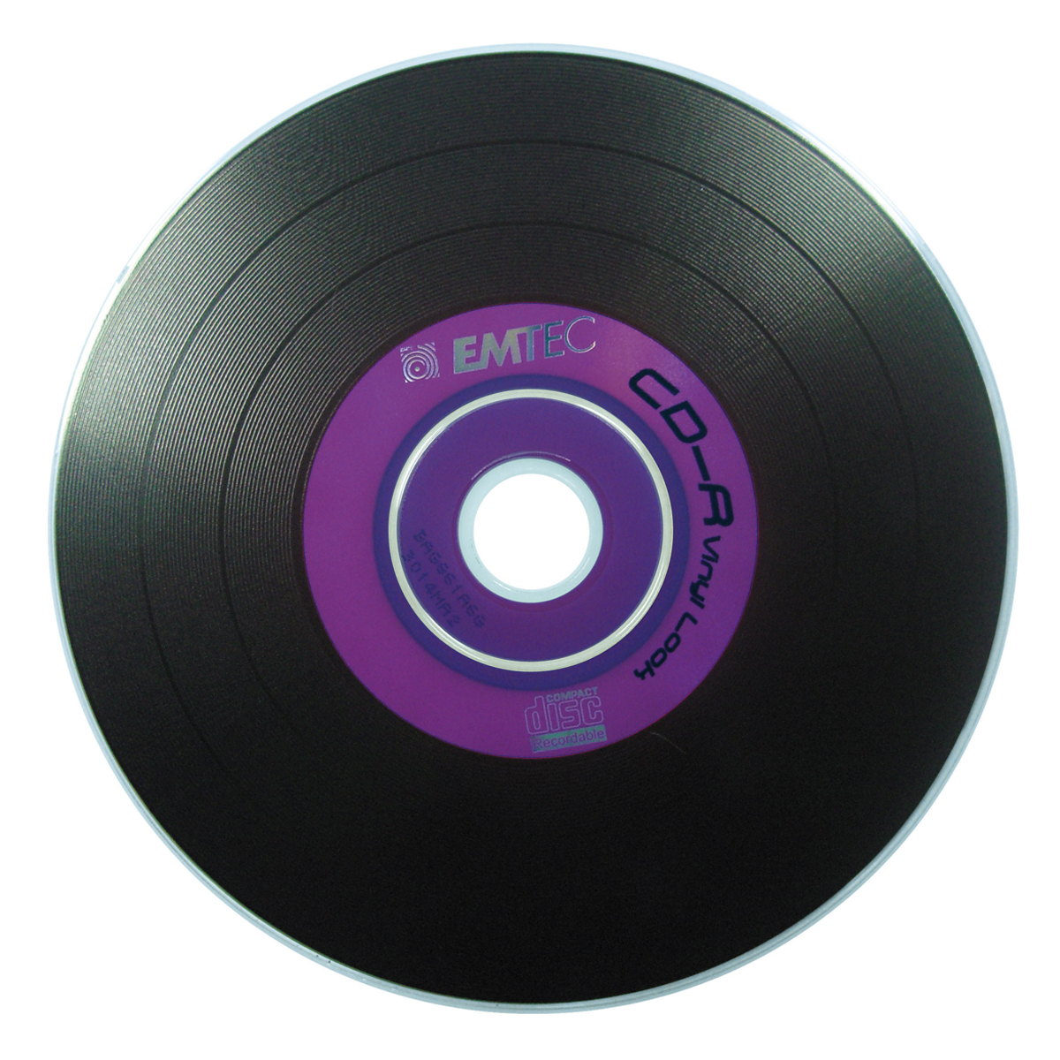



Multi-unit auction: The setting

Slide 4
The Bayesian setting
Each bidder i has a valuation v_{i} for the item which is drawn from a publicly-known probability distribution D_{i}
Myerson’s solution gives an auction which maximizes the expected revenue

Slide 5
The prior-free setting
Prior information may be costly or even impossible
Prior-free auctions:
Do not require knowledge of the probability distributions
Compete against some performance benchmark instance-by-instance

Slide 6
Benchmarks for prior-free auctions
Bids: Assume v₁> v₂>…> v_{n}
Compare the revenue of an auction to
Sum of values: Σ_{i} v_{i} (unrealistic)
Optimal single-price revenue: max_{i} i * v_{i} (problem: highest value unattainable; for the same reason that first-price auction is not truthful)
F⁽²⁾ (v) = max_{i>=2} i * v_{i} Optimal revenue for
Single price
Sell to at least 2 buyers
M⁽²⁾ (v) : Benchmark for ordered bidders with dropping prices

Slide 7
F⁽²⁾ and M⁽²⁾ pricing

Slide 8
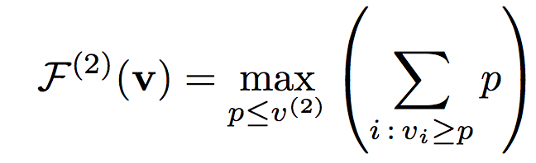
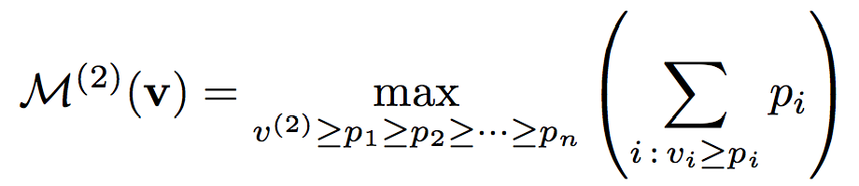
F⁽²⁾ and M⁽²⁾
Let v₁, v₂ , …, v_{n} be the values of the bidders in the given order
Let v⁽²⁾ be the second maximum
We call an auction c-competitive if its revenue is at least F⁽²⁾/c or M⁽²⁾/c

Slide 9
Motivation for M⁽²⁾
F⁽²⁾ <= M⁽²⁾ <= log n * F⁽²⁾
An auction which is constant competitive against M⁽²⁾ is simultaneously near optimal for every Bayesian environment of ordered bidders
Example 1: v_{i} is drawn from uniform distribution [0, h_{i}], with h₁ <= … <= h_{n}
Example 2: Gaussian distributions with non-decreasing means

Slide 10
Some natural offline auctions
profit
DOP (deterministic optimal price) : To each bidder offer the optimal single price for the other bidders. Not competitive.
RSOP (random sampling optimal price)
Partition the bidders into two sets A and B randomly
Compute the optimal single price for each part and offer it to each bidder of the other part
4.68-competitive. Conjecture: 4-competitive
RSPE (random sampling profit extractor)
Partition the bidders into two sets A and B randomly
Compute the optimal single-price revenue for each part and try to extract it from the other part
4-competitive
Optimal competitive ratio in 2.4 .. 3.24
profit
b₁
b₂
p₃
b₅
price
b₃
b₄
b₇
b₆
price

Slide 11
In this talk: two extensions
Online auctions
The bidders are permuted randomly
They arrive one-by-one
The auctioneer offers take-it-or-leave prices
Offline auctions with ordered bidders
Bidders have a given fixed ordering
The auction is a regular offline auction
Its revenue is compared against M⁽²⁾

Slide 12
Online auctions
Benchmark F⁽²⁾
Joint work with George Pierrakos

Slide 13
Online auction - example
Prices :
-
4
4
3
Bids :
4
6
3
…
Algorithm Best-Price-So-Far (BPSF): Offer the price which maximizes the single-price revenue of revealed bids

Slide 14
F⁽²⁾ pricing

Slide 15
Related work
Prior-free mechanism design
Secretary model
-offline mechanisms mostly
-online with worst-case arrivals
-generalized secretary problems
-mostly social welfare
-from online algorithms to online mechanisms
RSOP is 7600-competitive [GHKWS02]
15-competitive [FFHK05]
4.68-competitive [AMS09]
Conjecture1: RSOP is 4-competitive
Majiaghayi, Kleinberg, Parkes [EC04]
Our approach: from offline mechanisms to online mechanisms
Notes:
Mention time strategyproof and time-discounting in secretary model work

Slide 16
Results
Disclaimer1: our approach does not address arrival time misreports
Disclaimer2: our approach heavily relies on learning the actual values of previous bids
The competitive ratio of Online
Sampling Auctions is between 4 and 6.48
Best-Price-So-Far has constant competitive ratio

Slide 17
From offline to online auctions
Transform any offline mechanism M into an online mechanism
If ρ is the competitive ratio of M, then the competitive ratio of online-M is at most 2ρ
Pick M=offline 3.24-competitive auction of Hartline, McGrew [EC05]
M
b_{j}
…
p_{π(1)}
p_{π(2)}
p_{π(j-1)}
p_{π(j)}

Slide 18
Proof of the Reduction
M
b_{π(t)}
-let F⁽²⁾(b₁,…, b_{n})=kb_{k}
-w.prob. the first t bids have exactly m of the k high bids
-for m≥2,
-therefore overall profit ≥
…
random order assumption
-w. prob. profit from t≥

Slide 19
Ordered bidders Benchmark M⁽²⁾
Joint work with Sayan Bhattacharya, Janardhan Kulkarni, Stefano Leonardi, Tim Roughgarden, Xiaoming Xu

Slide 20
M⁽²⁾ pricing

Slide 21
History of M⁽²⁾ auctions
Leonardi and Roughgarden [STOC 2012] defined the benchmark M⁽²⁾
They gave an auction which has competitive ratio O(log* n)

Slide 22
Our Auction

Slide 23
Revenue guarantee: Proof sketch

Slide 24
Bounding the revenue of v^{B}
Prices are powers of 2
If there are many values at a price level, we expect them to be partitioned almost evenly among A and B.
Problem: Not true because levels are biased. They are created based on v^{A} (not v).
Cure: Define a set of intervals with respect to v (not v^{A}) and show that
They are relatively few such intervals
They are split almost evenly between A and B
They capture a fraction of the total revenue of A

Slide 25
Open issues
Offline auctions: many challenging questions (optimal auction? Competitive ratio of RSOP?)
Online auctions: Optimal competitive ratio? Is BPSF 4-competitive?
Ordered bidders: Optimal competitive ratio?
The competitive ratio of our analysis is very high
Online + ordered bidders?

Slide 26
Thank you!

